Slide 1
Photography
Unit 5 – SLR Camera Usage

Slide 2
Unit 5 – SLR Camera Usage
Section 3 – Rule of Thirds

Slide 3
The big idea
Organizing your pictures
Creating a natural viewable image
Portraits and landscape setup

Slide 4
Google Classroom Code
Photography
rhxkpt
Photography
7mdo2ur

Slide 5
Rule of Thirds
The Rule of Thirds is perhaps the most well-known ‘rule’ of photographic composition.
Can help you create well balanced and interesting shots.
The basic principle behind the rule of thirds is to imagine breaking an image down into thirds (both horizontally and vertically) so that you have 9 parts

Slide 6
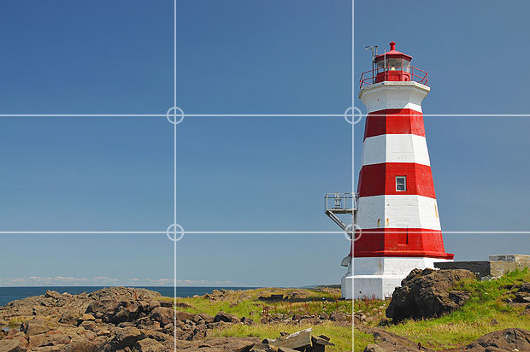

Slide 7
Rule of Thirds
Identies four important parts of the image that you should consider placing points of interest in as you frame your image.
The theory is that if you place points of interest in the intersections or along the lines that your photo becomes more balanced
Studies have shown that when viewing images that people’s eyes usually go to one of the intersection points most naturally rather than the center of the shot

Slide 8
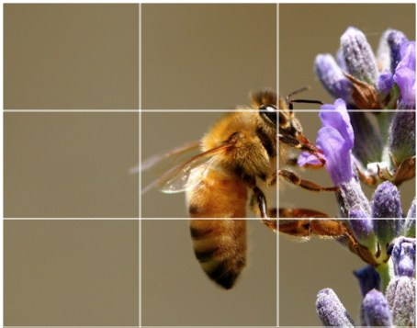

Slide 9
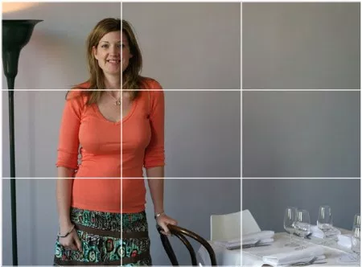

Slide 10
Rule of Thirds
This shot the subject is along a whole line which means she is considerably off center and therefore creating an additional point of interest. Placing her right in the center of the frame could have resulted in an ‘awkward’ shot.

Slide 11
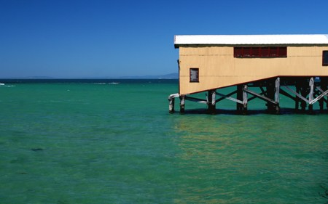

Slide 12
Rule of Thirds
A good technique for landscape shots is to position horizons along one of the horizontal lines

